Slide 1

Project 8. Twitter COVID19 Network Analysis II
by Matt Stirling

Slide 2
Project Specification
Look at the TweetsCOV19 dataset, a corpus of tweets related to the pandemic
Limit tweets to between Dec 2019 – Feb 2020 (3 months)
Construct network using hashtags
Save adjacency matrix
Analyse aspects of the network
Connected components
Average shortest path
Degree centrality
Analyse evolution of the dataset/network
Sentiment
Transitivity
Balanced / unbalanced triangle

Slide 3
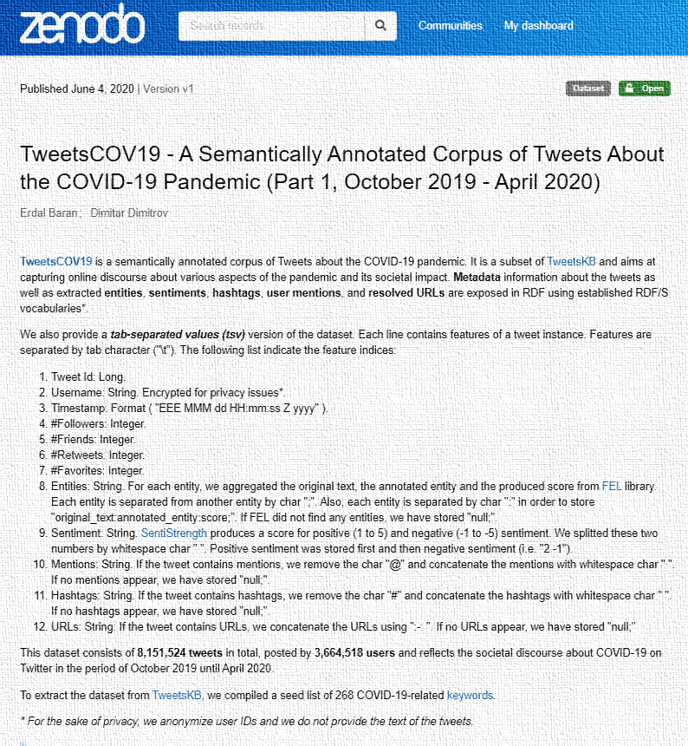
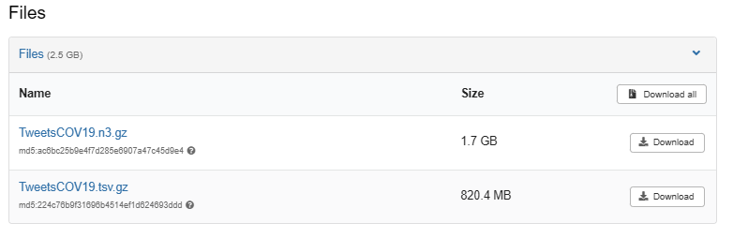
TweetsCOV19 dataset
https://zenodo.org/records/3871753
A semantically annotated corpus of Twitter about COVID19 aiming at capturing online discourse about various aspects of the pandemic and its social impact.
Tweets selected based on 268 words linked to pandemic
Over 8 million anonymised tweets, each with 12 features
We care about
Twitter Id
Timestamp
Positive/Negative sentiment
Hashtags
Download TSV:

Slide 4
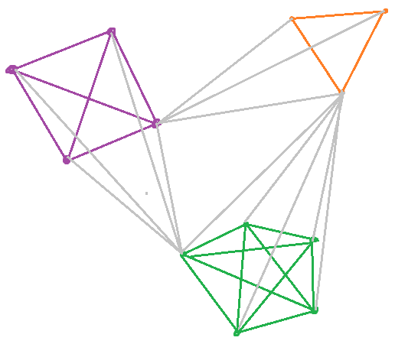
How to construct the Network
Nodes represent individual tweets
Defined by Twitter Id
Edges between tweets that share the same hashtag
Highly connected
Many fully connected subgraphs
Lots of edges
n tweets -> “n choose 2” edges
10,000 tweets -> 50,000,000 edges
Lots of edges, problem?

Slide 5
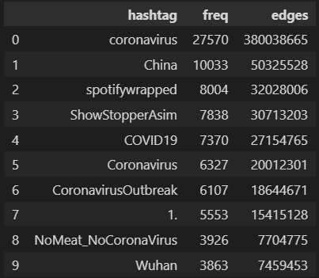
Hashtags
Top 10 most used hashtags
292,264 hashtags used
81,931 hashtags with more than 1 use
#coronavirus is most used hashtag
27,000 tweets
Minimum of 380 million edges added to network

Slide 6
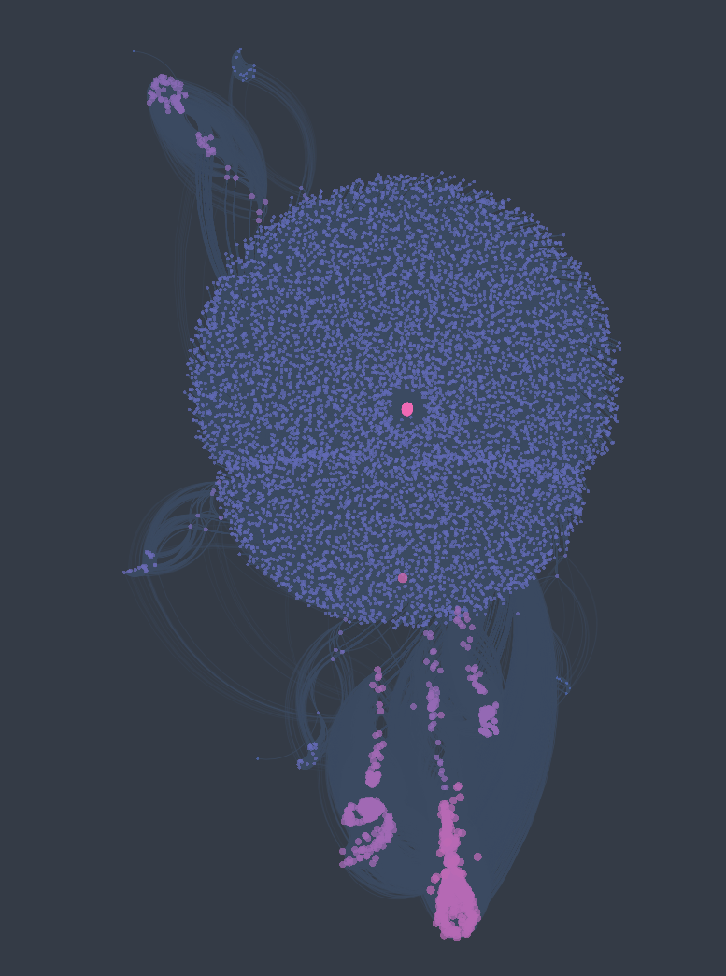
Network construction
Nodes
1,848,756 tweets between Dec 2019 and Feb 2020
462,901 (25% of above) tweets have hashtags
410,885 (89% of above) tweets will be connected
Edges
684,732,453 edges created
55% just from #coronavirus hashtags fully connected subgraph
0.4% of all possible edges, sparce adjacency matrix
Using cosmograph.app to display 0.1% of edges

Slide 7
Major Challenge
Edge list is too large to fit in RAM
Initial edge list over 25GB
Adjacency matrix over 160GB
Difficult / impossible to load dataset into graphing library such as NetworkX or iGraph
Run out of memory when calling methods on graph

Slide 8
Overcoming the Challenge
Find ways to manage data in partitions
Use faster graphing library
iGraph instead of NetworkX
Estimate parameters by analysing subgraph
Transitivity
Analyse parameters without graph library
Degree centrality
Gain insight through other methods
Nodes as hashtags. What
Modify task slightly
Sliding window vs. Cumulative

Slide 9

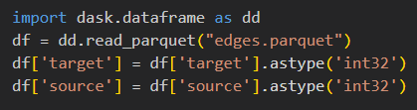
Loading edge list: Dask over Pandas
Pandas Data Frame
Loading whole edge list takes over 5 minutes
Dask Data Frame
Lazy loading
Data loaded in partitions (of Pandas DataFrames)
Loading edge list takes 5 seconds
Parquet over CSV
CSV file was around 25GB
Parquet file around 1GB (on disk, compressed)

Slide 10
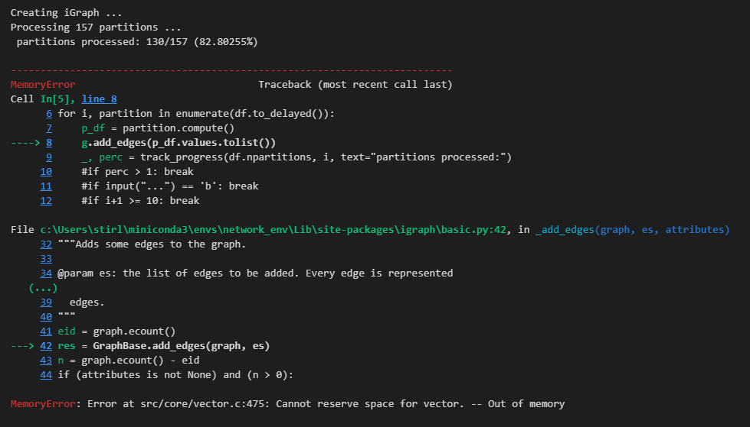
Loading edge list into iGraph
Many attempts resulted in MemoryError

Slide 11
Loading edge list into iGraph: Success!
After much testing, managed to finally load all edges into iGraph
Convert data frame columns to ‘int32’
Load one partition at a time
Time to load graph: around 6 hours
Computations done with graph:
... TBA
# Load edges from dask dataframe to igraph
g = ig.Graph()
g.add_vertices(len(nodes))
for i, partition in enumerate(df.to_delayed()):
p_df = partition.compute()
g.add_edges(p_df.values.tolist())

Slide 12
Adjacency Matrix
Goal:
Generate adjacency matrix in a format that can be read into some usable format
410,000^2 bytes is 168GB
Assumes each cell is int8 dtype
No obvious way to store each connection as 1 bit
Even bool uses 8 bits

Slide 13
Adjacency Matrix: Creation
Tested 2 ways to generate matrix:
Scipy CSR (Compressed Sparse Row) Matrix
Only 0.4% of matrix cells are 1s, matrix is sparse
Save to .npz format, compressed to a few GB
On my machine, PC freezes when trying to create whole matrix
Dask Array
Load data in partitions
Save in .zarr format (around 75 GB)
Technical challenges in actually creating matrix
Still working on it ...

Slide 14
Average path length
Average path length is ...
Possible using iGraph
load graph takes 6 hours
igraph.average_path_length() takes ? hours
ToDo:
Run code for a few days?

Slide 15
Graph from Hashtags
Let’s approach problem from different angle ...
Nodes in same #hashtag group are definitionally fully connected
Construct a new graph, where:
Nodes represent #hashtags
Edges are drawn when a tweet contains both #hashtags
Insights into true network?
Diameter
Connected components
Communities
Average shortest path between hashtags

Slide 16
Connected components
Don’t need graph library
Implement UnionFind algorithm
UnionFind data structure:
Initialize and find components:
class UnionFind:
def __init__(self, n):
self.parent = [i for i in range(n)]
self.rank = [0] * n
self.size = [1] * n
def find(self, u):
if self.parent[u] != u:
self.parent[u] = self.find(self.parent[u])
return self.parent[u]
def union(self, u, v):
pu, pv = self.find(u), self.find(v)
if pu == pv:
return
if self.rank[pu] < self.rank[pv]:
self.parent[pu] = pv
self.size[pv] += self.size[pu]
elif self.rank[pv] < self.rank[pu]:
self.parent[pv] = pu
self.size[pu] += self.size[pv]
else:
self.parent[pu] = pv
self.rank[pv] += 1
self.size[pv] += self.size[pu]
# Initialize union find
nodes = set(edges['source']).union(set(edges['target']))
node_index = {node: i for i, node in enumerate(nodes)}
n = len(nodes)
uf = UnionFind(n)
for _, row in edges.iterrows():
uf.union(node_index[row['source']], node_index[row['target’]])
# find components
comps = {}
for node, i in node_index.items():
parent = uf.find(i)
comps[parent] = comps.get(parent, []) + [node]

Slide 17
Connected components
10 largest components:
# | Amount of nodes
1 | 385468
2 | 95
3 | 80
4 | 78
5 | 71
6 | 68
7 | 67
8 | 59
9 | 57
10 | 52
7,746 connected components
Largest component
385,468 nodes (94%) of all connected nodes
Average component size is 53 nodes
Without largest component is 3.3

Slide 18
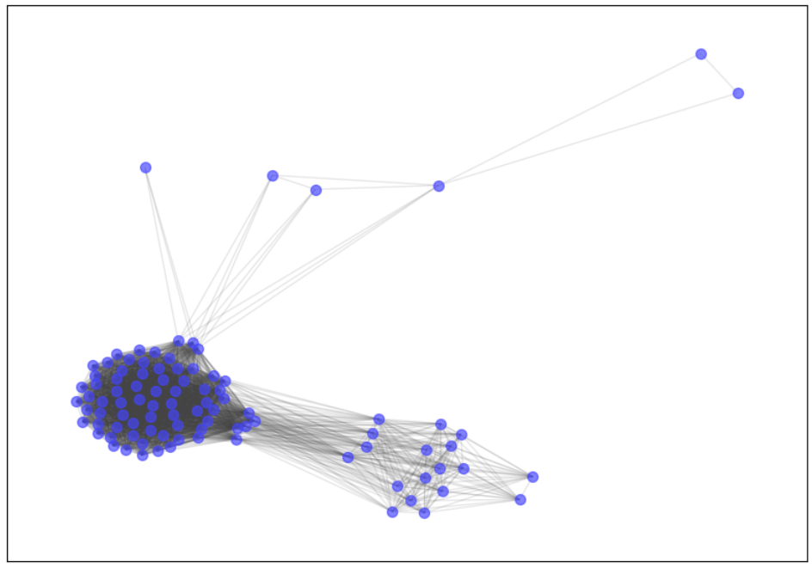
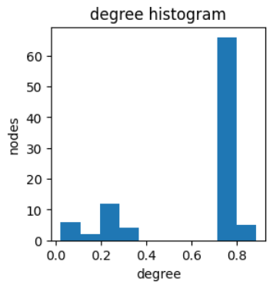
2nd largest connected component
Nodes: 95
Hashtags: 15
#BarişArduç #SenolSomnez #BarısArducMutluYıllar #BurcuBiricik #ElBar #omerlplikci #Kuzgun #ElcinSangu #Șenolsönmez #Deföm #Kuzdil #DefOm #BarışArduç #ElbarWithNewSeriesOnStarTv #NewSeriesWithElbar

Slide 19
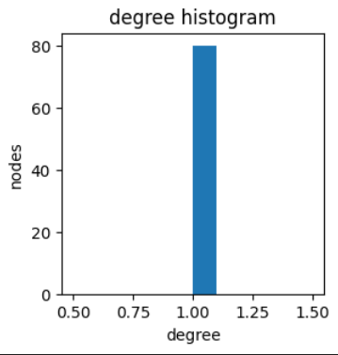
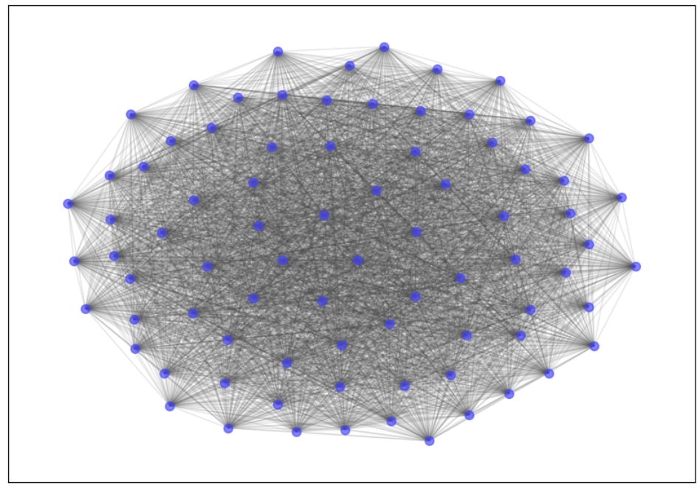
3rd largest connected component
Nodes: 80
#AAG #AAG2020

Slide 20
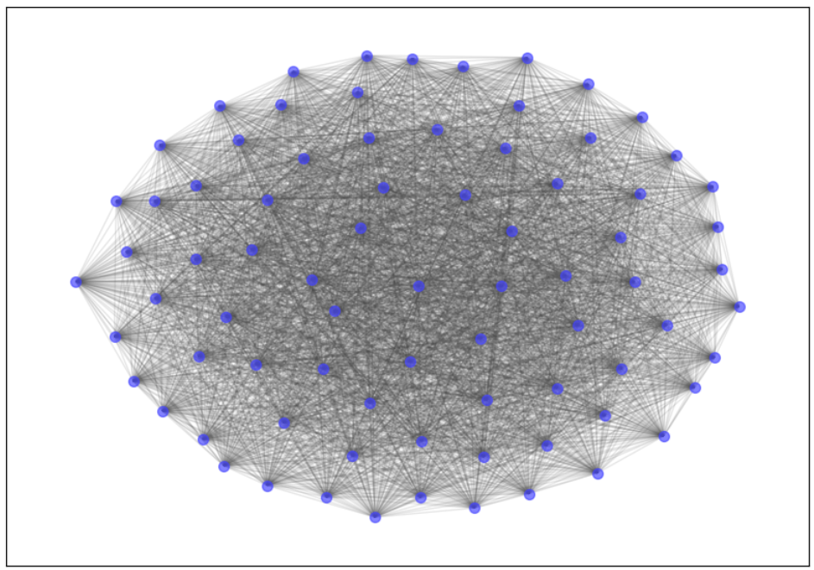
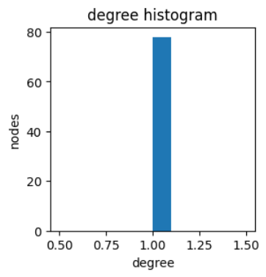
4th largest connected component
Nodes: 78
#BetterBanking

Slide 21
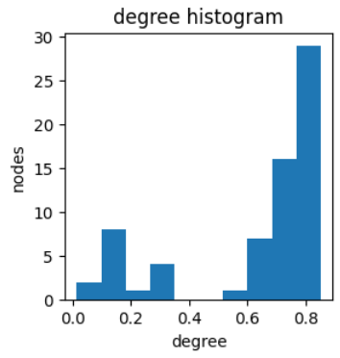
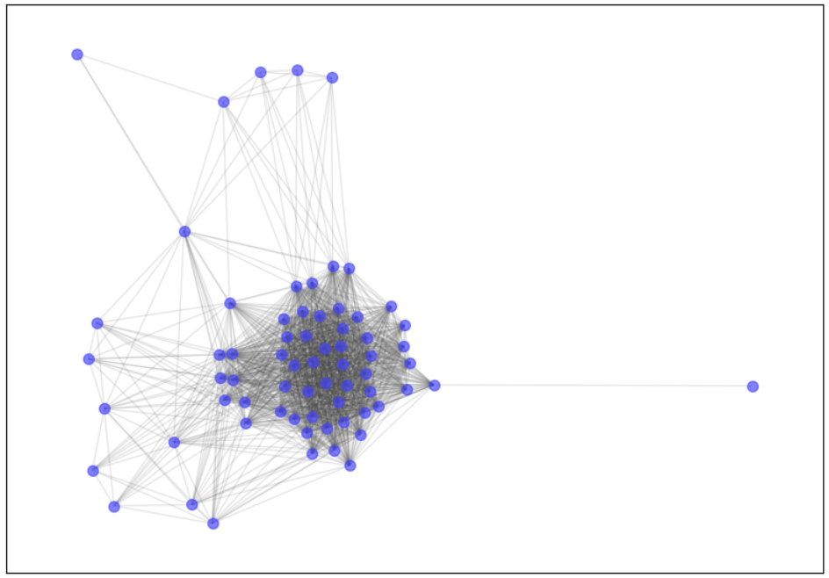
5th largest connected component
Nodes: 68

Slide 22
Title
bullet

Slide 23
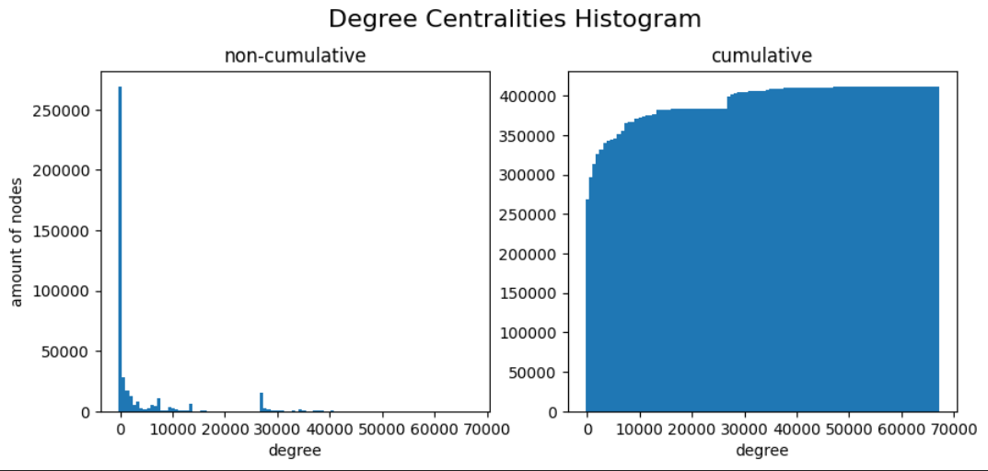
Degree centralities
min: 1
max: 67,496
mean: 3,332

Slide 24
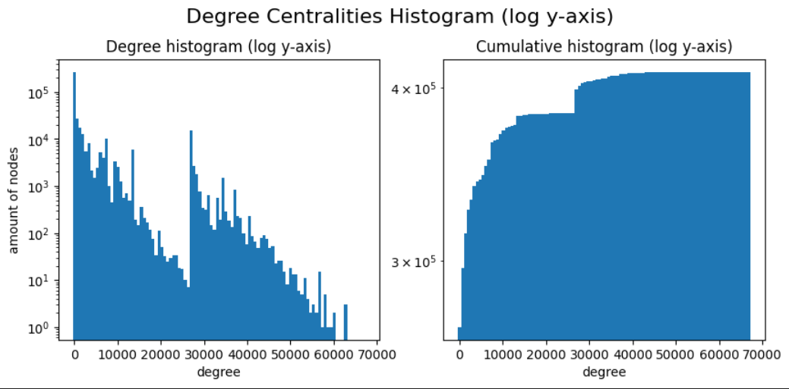
Degree centralities log
Y-axis to log

Slide 25
Degree centralities w/ Hashtag Effect
Bulletpoint

Slide 26
Degree centralities: Power law fit
Bulletpoint

Slide 27
Evolution of Tweet Sentiment
Tweets have positive and negative sentiment features
Positive: value between 0 and 5
Negative: value between -5 and 0
Task:
Divide 3 month period into 100 subdivisions
For each subdivision, calculate average positive and negative sentiment of all the tweets up to that point
Don’t need graphing libraries

Slide 28
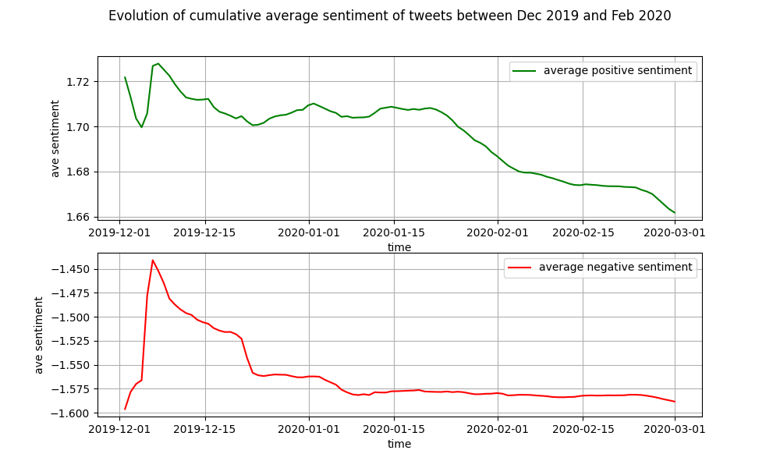
Evolution of Tweet Sentiment: Graph
bullet

Slide 29
Evolution of Transitivity
Using the same time subdivisions as before ...
Estimate the transitivity of the graph up to each subdivision
igraph.transitivity_undirected() to get global transitivity
As graph gets larger, this gets harder and harder ...
Alternatives:
Take non-cumulative subdivision
Use sliding window (e.g. 10 time divisions)

Slide 30
Evolution of Transitivity: Graph
Bulletpoint

Slide 31
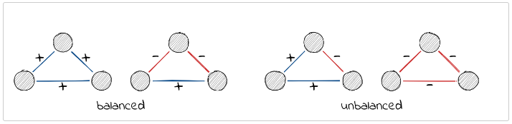
Structural balance
Add together positive and negative sentiment
See whether triangles are balanced or unbalanced:
Balanced: product of nodes is positive
Unbalanced: product negative
Using the same time subdivisions:
analyse change in proportion of balanced vs unbalanced triangles

Slide 32
Structural balance: ToDo
Find efficient way to identify triangles
NetworkX perhaps better for this, but unable to load whole graph

Slide 33
Virus propogation
Analyse occurrence of unbalanced triangles as a “virus propagation case”
Requires the previous task to be completed ...

Slide 34
Final thoughts
Rewarding but very challenging project
Will try my best to finish the remaining tasks

